Slide 1
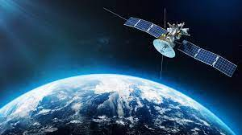

RGC campus , Chola nagara
Banglore-560032
DEPARTMENT OF COMPUTER SCIENCE AND ENGINEERING
PROJECT TITLE:
WORKING OF SATELLITE VISUALIZATION
UNDER THE GUIDANCE OF:
PROF . BHAGYASHRI WAKDE
PRESENTED BY:
BHAVANA S K (1RG20CS019)
MADHU S (1RG20CS033)

Slide 2
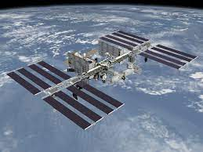
INTRODUCTION
Eyes in the sky, space mirror bouncing phone call round earth, heavenly composes helping us home – these are just three of the things that satellites do for us.
What is a satellite ?
“Satellite” ,means a smaller, space-based object moving in the loop (an orbit) around a larger object.
For example : Moon is a natural satellite of earth, because gravity locks it in orbit around our planet.
How does satellite help us?
1. If you want to make a phone call from a north pole, you can fire a signal into space and back down again, using a communications satellite as a mirror to bounce the signal back to the earth and its destination.

Slide 3
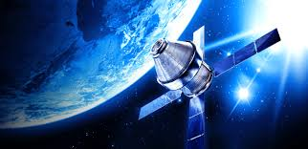
2. If you want to survey crops or ocean temperatures, you could do it this from plane, but a satellite can capture more data more quickly because it’s a higher up and further along.
Similarly, if you want to drive somewhere you have never been before, you could study maps or ask random strangers for directions, or you could use signals from satellites to guide you instead.
What do satellites do for us?
A satellite does usually determines the things like , how far away from earth it needs to be , how fast it has to move , and the orbit it as to follow.
The three main uses of satellites are:
1.Communications.
2.Photography,imaging and scientific surveying.
3.Navigation.

Slide 4
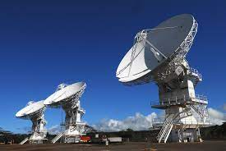
MOTIVATION
Main aim of this Mini Project is to illustrate the concepts of working of a Satellite in OpenGL.
OpenGL is a cross-language, cross-platform application programming interface (API) that can be used to render 2D and 3D vector graphics with a ton of features and customization.
It also demonstrates animating objects using transformation functions in OpenGL.
The purpose of this project is to demonstrate the functionality of Rotation in OpenGL.
And visualizing animating the movement of earth and satellite using OpenGL commands.
A Satellite is an object which has been placed into orbit by human endeavor. Such objects are sometimes called artificial satellites to distinguish them from natural satellites such as the Moon

Slide 5
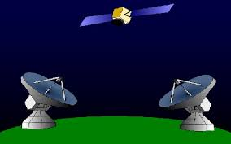
SYSTEM REQUIREMENTS SPECIFICATION
HARDWARE REQUIREMENTS
RAM: 2GB and higher>
Hard Disk: 40GB and higher
Monitor: 1024 x 768 display Resolution
SOFTWARE REQUIREMENTS
Programming Language: C++ using OpenGL.
Operating System: Windows Operating System
Compiler-GCC compiler
Graphics library: GL/glut.h
OpenGL 17.12

Slide 6

OPENGL COMMANDS USING FOR ANIMATING
1.glPushMatrix();
The glPushMatrix function pushes the current matrix stack down by one, duplicating the current matrix. That is, after a glPushMatrix call, the matrix on the top of the stack is identical to the one below it.
2.glColor3f();
glColor3f can be called in between glBegin and glEnd. When it is used this way, it can be used to give each vertex its own color.
3.glTranslatef();
The glTranslatef function produces the translation specified by (x, y, z). The translation vector is used to compute a 4x4 translation matrix: The current matrix (see glMatrixMode) is multiplied by this translation matrix, with the product replacing the current matrix.
4.glutSolidSphere();
The glutSolidSphere() function draws a shaded sphere centered at the origin. The sphere is subdivided around the Z axis into slices and along the Z axis into stacks.
5.glPopMatrix();
The glPopMatrix function pops the current matrix stack, replacing the current matrix with the one below it on the stack.

Slide 7
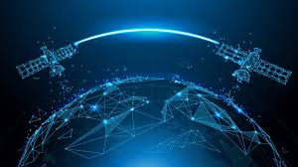
6.glRotatef();
The glRotatef function computes a matrix that performs a counterclockwise rotation of angle degrees about the vector from the origin through the point (x, y, z).
7.glutSwapBuffers();
glutSwapBuffers swaps the buffers of the current window if double buffered. Performs a buffer swap on the layer in use for the current window.
8.glScaled();
The glScalef function produces a general scaling along the x, y, and z axes. The three arguments indicate the desired scale factors along each of the three axes.
9.glLoadIdentity();
The glLoadIdentity function replaces the current matrix with the identity matrix. It is semantically equivalent to calling glLoadMatrix with the following identity matrix.
10. glutCreateWindow();
glutCreateWindow creates a top-level window. The name will be provided to the window system as the window's name. The intent is that the window system will label the window with the name.

Slide 8
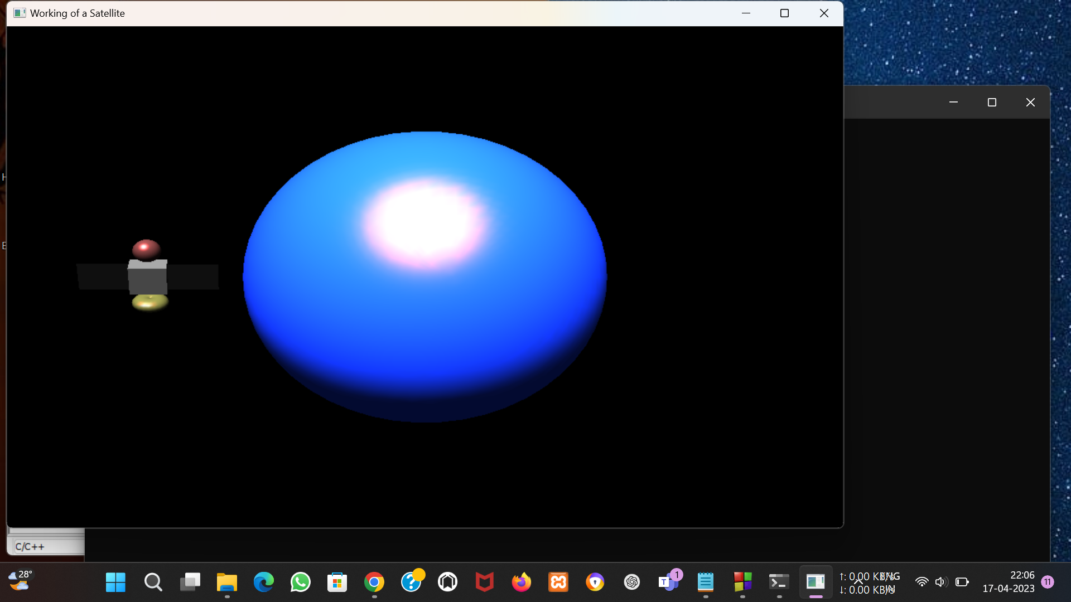
EXPECTED OUTPUT OF OUR PROJECT

Slide 9
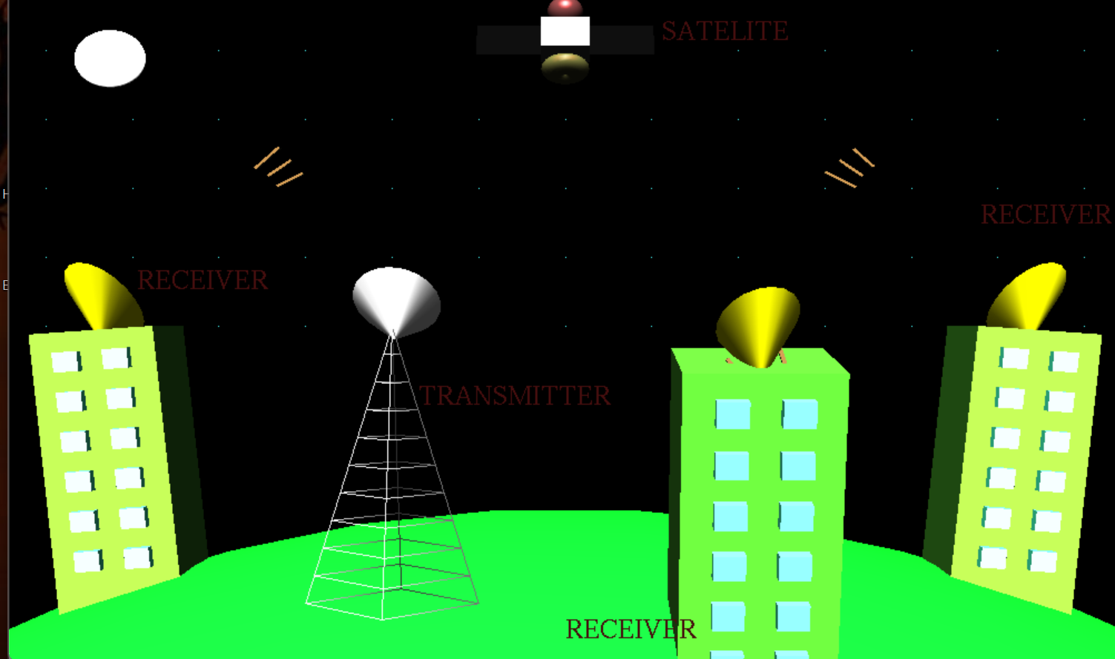

Slide 10
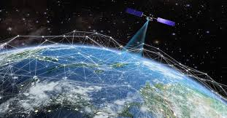
CONCLUSION
The project “WORKING OF SATELLITE in OpenGL” was designed and implemented by us its creators as the exercise of “Computer Graphics and Visualization” Laboratory. More features to make it a competitive. Further work on projects like this would enable greater knowledge in OpenGL. An attempt has been made to develop a OpenGL graphics package, which meets the necessary requirements of the user successfully. This project has given us an insight into the use of Computer Graphics. As we have had to use many built-in and user defined functions, we have managed to get a certain degree of familiarity with these functions and have generally understood the power of these functions and were able to comprehend the true nature of the most powerful tool graphics in OpenGL and also have understood to a reasonable extent the reason why Graphics is so powerful for animation programmers. We can now converse with a certain degree of confidence about Graphics in OpenGL

Slide 11
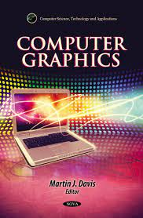
BIBLIOGRAPHY
Books Reference
1.Donald Hearn & Pauline Baker: Computer Graphics with OpenGLVersion, 3rd/4th Edition, Pearson Education, 2011.
2.Edward Angel: Interactive Computer Graphics- A Top Down approach with OpenGL, 5th edition. Pearson Education, 2008.
WEBSITES
1. http://www.opengl-tutorial.org/
2. https://hackr.io/tutorials/learn-opengl
3. https://github.com/JoeyDeVries/LearnOpenGL
4. https://www.geeksforgeeks.org/getting-started-with-opengl/

Slide 12


